Slide 1

JCAPS 5.1 Web Service POC
Phani Krishna

Slide 2
Web service Provider Scenario
Components Required
  XSD Files ( For Request/Response)
  Object Type Definitions
  Connectivity Map
  Java Collaboration
  Deployment Profile
  External Systems

Slide 3
Object Type Definitions – Request XSD
Request XSD
  <?xml version="1.0" encoding="UTF-8"?>
  <xsd:schema xmlns:tns="urn:please.define.your.own.target.Add2Input" xmlns:xsd="http://www.w3.org/2001/XMLSchema"
  targetNamespace ="urn:please.define.your.own.target.Add2Input" elementFormDefault="qualified" attributeFormDefault="unqualified">
  <xsd:complexType name="Add2Input">
  <xsd:sequence maxOccurs="unbounded">
  <xsd:element name="num1" type="xsd:integer"/>
  <xsd:element name="num2" type="xsd:integer"/>
  </xsd:sequence>
  </xsd:complexType>
  <xsd:annotation>
  <xsd:documentation>Comment describing your root element</xsd:documentation>
  </xsd:annotation>
  <xsd:element name="Add2Input" type="tns:Add2Input"/>
  </xsd:schema>

Slide 4
Object Type Definitions – Response XSD
Response XSD
  <?xml version="1.0" encoding="UTF-8"?>
  <xsd:schema xmlns:tns="urn:please.define.your.own.target.Add2Output" xmlns:xsd="http://www.w3.org/2001/XMLSchema"
  targetNamespace ="urn:please.define.your.own.target.Add2Output" elementFormDefault="qualified" attributeFormDefault="unqualified">
  <xsd:complexType name="Add2Output">
  <xsd:sequence maxOccurs="unbounded">
  <xsd:element name="Result" type="xsd:integer"></xsd:element>
  </xsd:sequence>
  </xsd:complexType>
  <xsd:annotation>
  <xsd:documentation>Comment describing your root element</xsd:documentation>
  </xsd:annotation>
  <xsd:element name="Add2Output" type="tns:Add2Output"/>
  </xsd:schema>

Slide 5
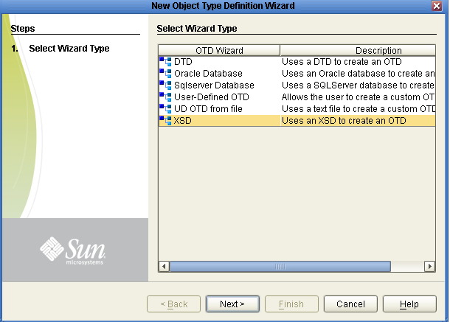
Building OTDs using OTD wizard

Slide 6
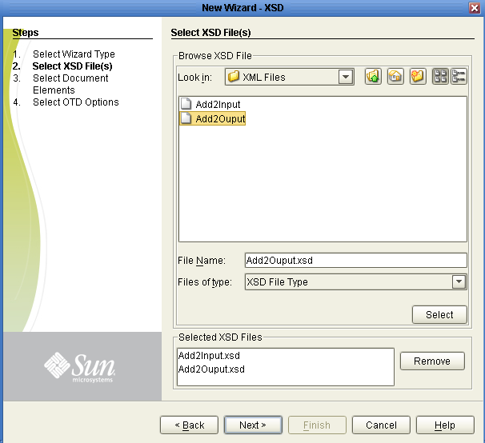
Building OTDs using OTD wizard (cont)

Slide 7
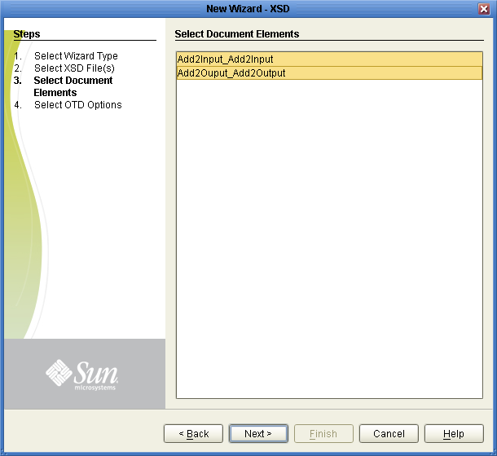
Building OTDs using OTD wizard(cont)

Slide 8
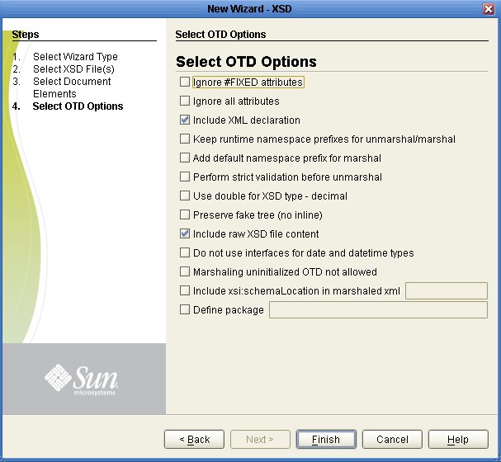
Building OTDs using OTD wizard(cont)

Slide 9
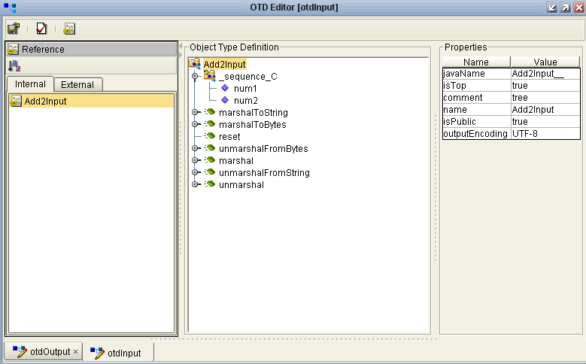
Request OTD

Slide 10
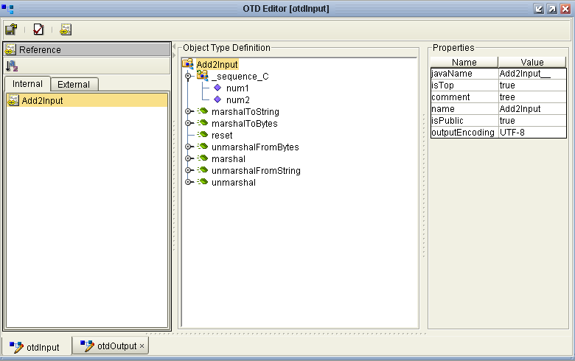
Response OTD

Slide 11
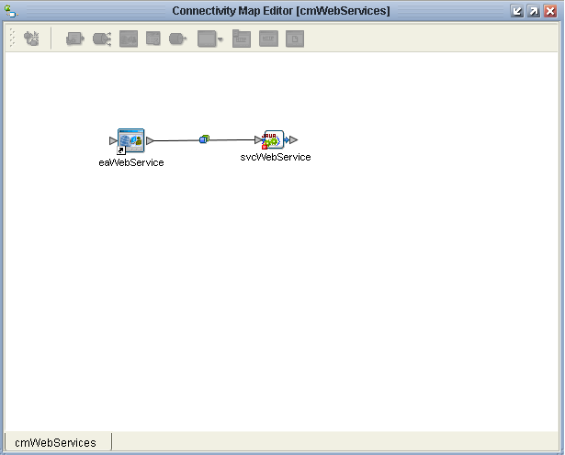
Connectivity Map

Slide 12
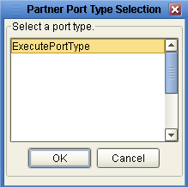
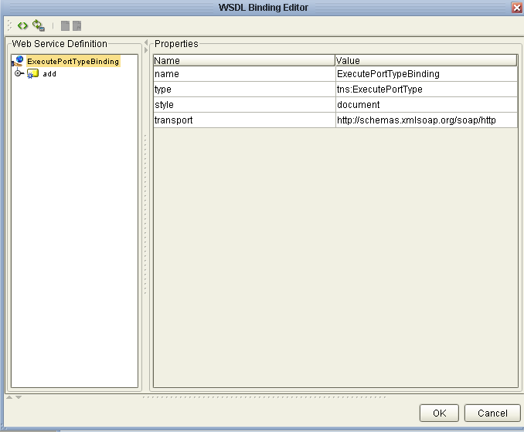
Web Service Configuration Parameter Settings
( eaWebService -> svcWebService)

Slide 13
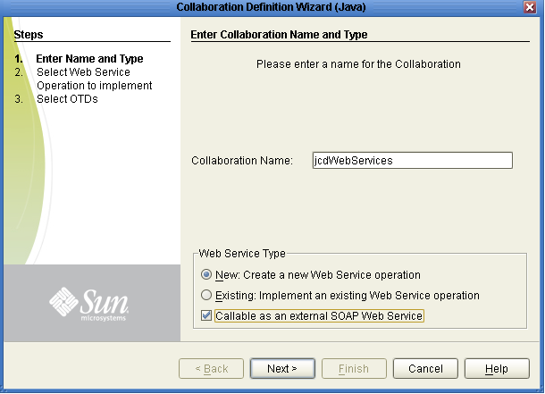
JCD Creation

Slide 14
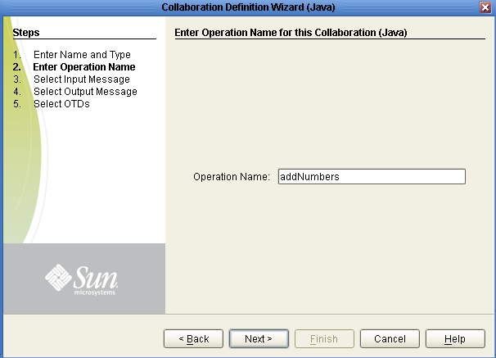
JCD Creation (cont)

Slide 15
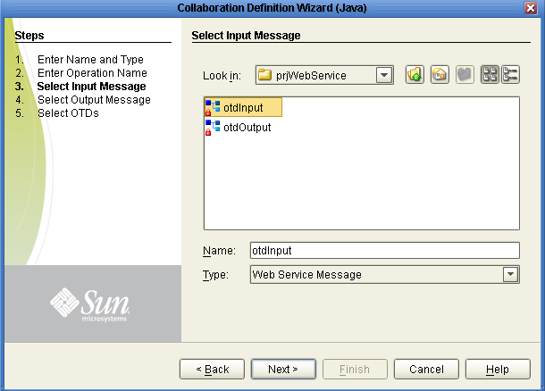
JCD Creation (cont)

Slide 16
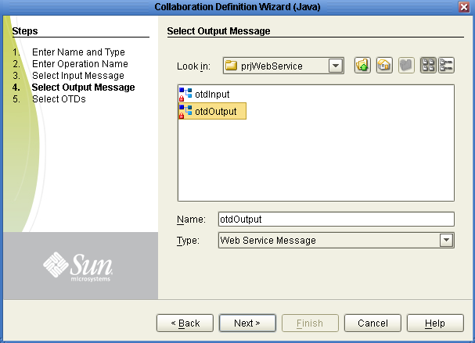
JCD Creation (cont)

Slide 17
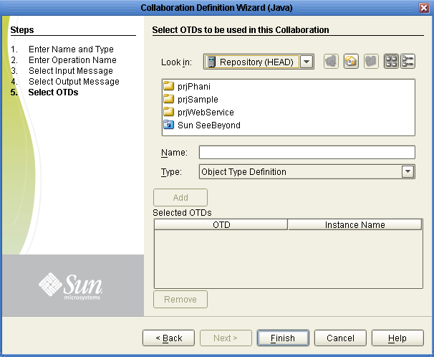
JCD Creation (cont)

Slide 18
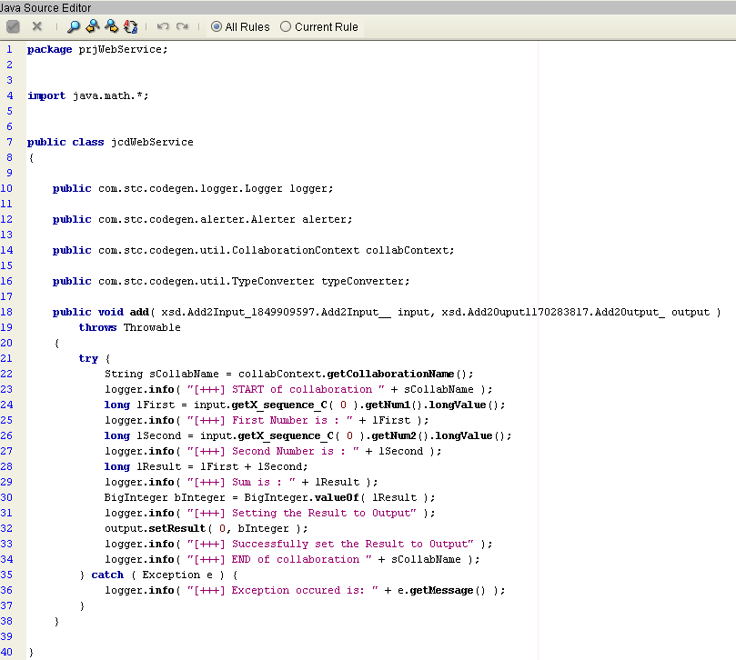
Jcd Code
(svcWebService)

Slide 19
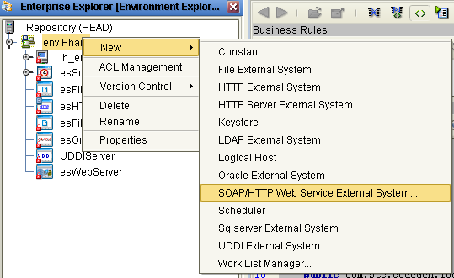
External System
(esWebServer)

Slide 20
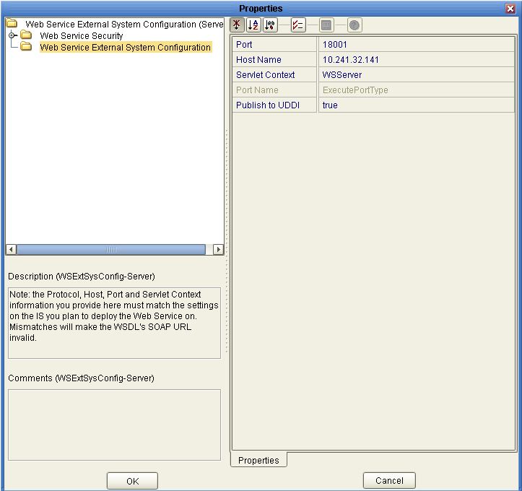
External System Configuration
(esWebServer)

Slide 21
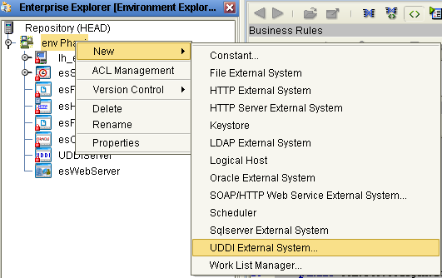
External System
(eaUDDIServer)

Slide 22
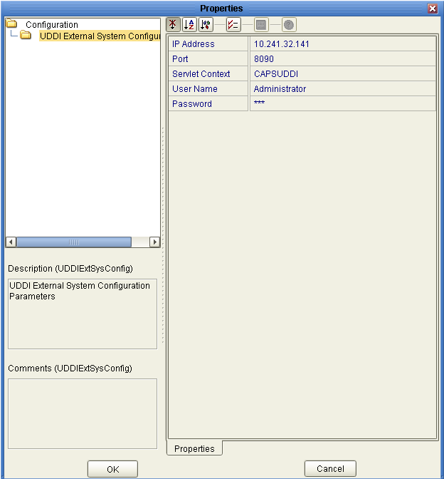
External System Configuration
(eaUDDIServer)

Slide 23
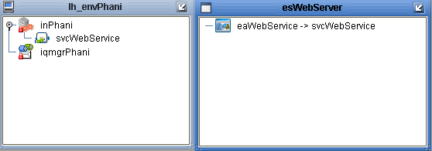
Deployment Profile
(dpWebService)

Slide 24
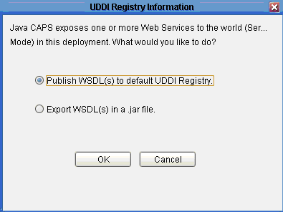
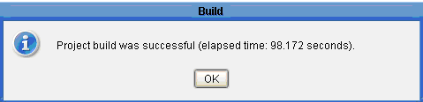
Deployment Profile (cont)
(dpWebService)

Slide 25
WSDL File
Path of WSDL File
../JCAPS5.1/uddidocs/environment/project/jcd/wsdl_(…..).wsdl

Slide 26
Thank You
Phani Krishna

